Slide 1
CS211 Computer Architecture Fall 2019
Section 10
Recitation 2

Slide 2
Update
Office hours are officially in Rutcor 111
W, Th 2-3pm
Next to Werblin

Slide 3
Links/Resources
Vim Commands
http://tldp.org/LDP/intro-linux/html/sect_06_02.html
Format Specifiers
https://codeforwin.org/2015/05/list-of-all-format-specifiers-in-c-programming.html
Stack/Heap/Malloc Info
https://people.cs.clemson.edu/~levinej/courses/S15/1020/handouts/lec01/MemoryAndMalloc.pdf

Slide 4
Today
Do you have access to iLab machines?
C Programming Review
Pointers
Arrays
Structs
malloc()/free()

Slide 5
Pointers
Data type that stores the memory address of whatever it is pointing to
int* ptr → pointer to an int
char* ptr → pointer to char
double* ptr → pointer to double
Note that there is no difference between
int* ptr & int *ptr

Slide 6
Pointers (contd.)
Operations example
Lets’s say the address of num is 0x214FA4
int* ptr;
int num = 6;
ptr = &num;
What would be the result of printing
ptr =
*ptr =
&ptr =
* = dereference aka getting the data from wherever ptr is pointing to
& = referencing aka getting the address in memory
address of num
value of ptr is pointing to → 6
address of ptr itself

Slide 7
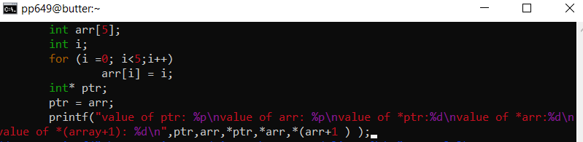
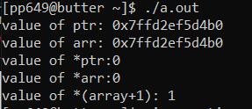
Arrays
Index starts at 0
The name of array points to first element
https://report.cs.rutgers.edu/nagiosnotes/iLab-machines.html
Values of:
ptr
arr
*ptr
*arr
*(array+1)

Slide 8
Recap
*ptr – returns value of whatever ptr is pointing to
&c – returns address of c
Use %p as the format specifier for a pointer to print an address
Addresses are in hex, so don’t use %d

Slide 9
Structs
A “variable” that defines multiple variables, which could be of different types
Analogous to an “object”
Can be used to implement data structures
Declare by using struct nameOfStruct yourStruct;
nameOfStruct – whatever the name of your struct is
yourStruct – the name of this “instance” of the struct

Slide 10
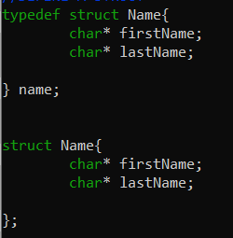

Structs (contd.)
Typedef structs are structs with names
easier to create a new struct
Makes syntax easier
Why do we care?
When declaring a struct, you’re telling the compiler how much memory to allocate given how many variables are inside of it

Slide 11
Structs Demo(?)

Slide 12
Dynamically Allocation Memory
Memory is allocated when you initialize variables and gets placed onto the stack (static memory allocation)
What if you don’t know how much space is needed?
You can dynamically allocate memory
The heap is where dynamic memory allocation takes place
malloc and new keyword

Slide 13
Stack vs Heap
Static memory
Stack stores memory of local variables and functions
Variables are pushed and popped when function is called and ended
Allocation and deallocation is done automatically
The stack is fixed in space
Dynamic memory
Heap stores global variables & ”objects”
User needs to manually allocate and deallocate memory
Variables can be resized

Slide 14
malloc() & free()
malloc
Allocates a block of memory depending on what size you provide
Returns pointer of your specified casting
Ex:
ptr = (int*) malloc (sizeof(int));
Use sizeof to compute the size of what you need to malloc
Use this to allocate a struct
free
After malloc is no longer needed, that memory should be freed for the heap to use later
May run out of memory if you don’t
For every malloc(), there should be a free()
Ex:
free(ptr);
Notes:
Rule of thumb, whenever you malloc, be sure to free

Slide 15
Reminder
Type | Size (Bytes)
char | 1
int | 4
short | 2
long | 8
float | 4
double | 8

